Slide 1
Internet Application Development – Lec10
By: p.pirapuraj

Slide 2
Web Application Security

Slide 3
Network Firewall
Network firewall they have in place to secure their network will also protect the websites and web applications sitting behind it.
Network security differs from web application security. In network security perimeter defenses such as firewalls are used to block the bad guys out and allow the good guys in.

Slide 4
Network Firewall…
But perimeter network defences are not suitable to protect web applications from malicious attacks.
Business websites and web applications have to be accessed by everyone, therefore administrators have to allow all incoming traffic on port 80 (HTTP) and 443 (HTPS) and hope that everyone plays by the rules.

Slide 5
Network Firewall…
Network firewalls cannot analyze web traffic sent to and from the web applications, therefore it can never block any malicious requests sent by someone trying to exploit a vulnerability such as an SQL injection or Cross-site Scripting.

Slide 6
Web Application Firewall(WAF)
A WAF or Web Application Firewall helps protect web applications by filtering and monitoring HTTP traffic between a web application and the Internet.
It typically protects web applications from attacks such as cross-site forgery, cross-site-scripting (XSS), file inclusion, and SQL injection, among others.

Slide 7
Cross-Site Request Forgery (CSRF)
A cross site request forgery attack is a type of confused deputy* cyber attack that tricks a user into accidentally using their credentials to invoke a state changing activity, such as transferring funds from their account, changing their email address and password, or some other undesired action.

Slide 8
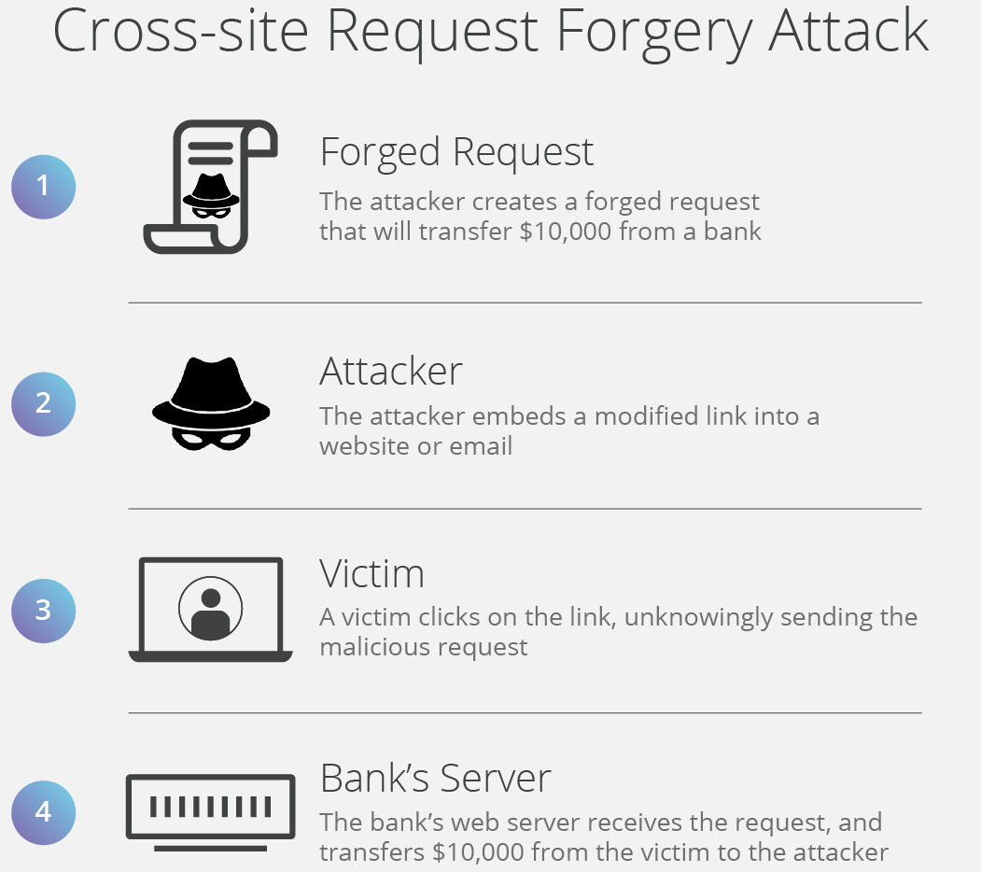

Slide 9
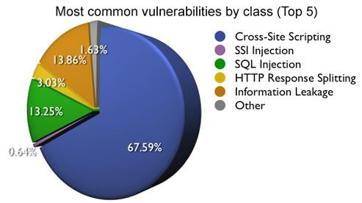
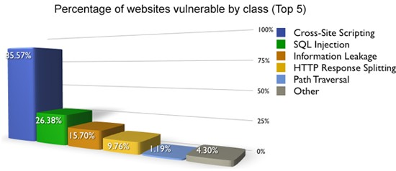

Slide 10
Cross-site scripting (XSS)
Cross-site scripting (XSS) is an exploit where the attacker attaches code onto a legitimate website that will execute when the victim loads the website.
That malicious code can be inserted in several ways. Most popularly, it is either added to the end of a url or posted directly onto a page that displays user-generated content. In more technical terms, cross-site scripting is a client-side code injection attack.

Slide 11
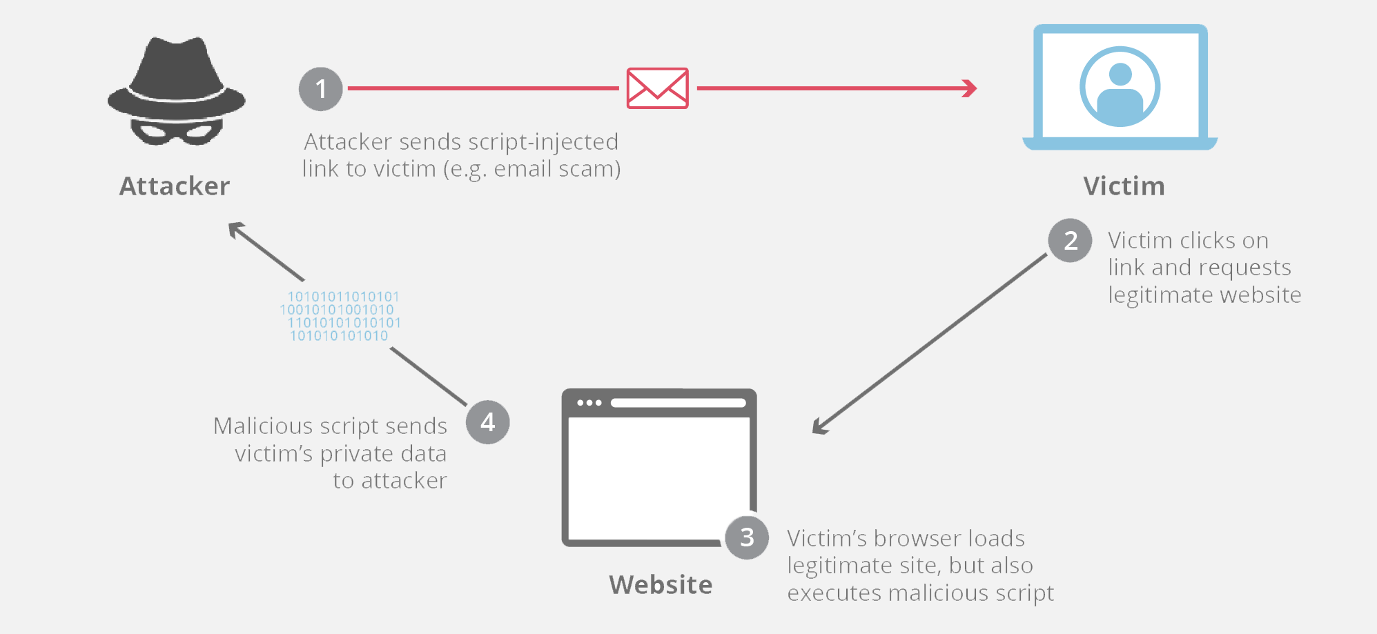
Cross-site scripting (XSS)

Slide 12
File Inclusion Vulnerabilities
Remote File Inclusion (RFI) and Local File Inclusion (LFI) are vulnerabilities that are often found in poorly-written web applications. These vulnerabilities occur when a web application allows the user to submit input into files or upload files to the server.

Slide 13
File Inclusion Vulnerabilities…
LFI vulnerabilities allow an attacker to read (and sometimes execute) files on the victim machine. This can be very dangerous because if the web server is misconfigured and running with high privileges, the attacker may gain access to sensitive information.

Slide 14
File Inclusion Vulnerabilities…
If the attacker is able to place code on the web server through other means, then they may be able to execute arbitrary commands.
RFI vulnerabilities are easier to exploit but less common. Instead of accessing a file on the local machine, the attacker is able to execute code hosted on their own machine.

Slide 15
WAF…
By deploying a WAF in front of a web application, a shield is placed between the web application and the Internet.
While a proxy server protects a client machine’s identity by using an intermediary, a WAF is a type of reverse-proxy, protecting the server from exposure by having clients pass through the WAF before reaching the server.

Slide 16
WAF…
A WAF operates through a set of rules often called policies. These policies aim to protect against vulnerabilities in the application by filtering out malicious traffic.
The value of a WAF comes in part from the speed and ease with which policy modification can be implemented, allowing for faster response to varying attack vectors; during a DDoS attack, rate limiting can be quickly implemented by modifying WAF policies.

Slide 17
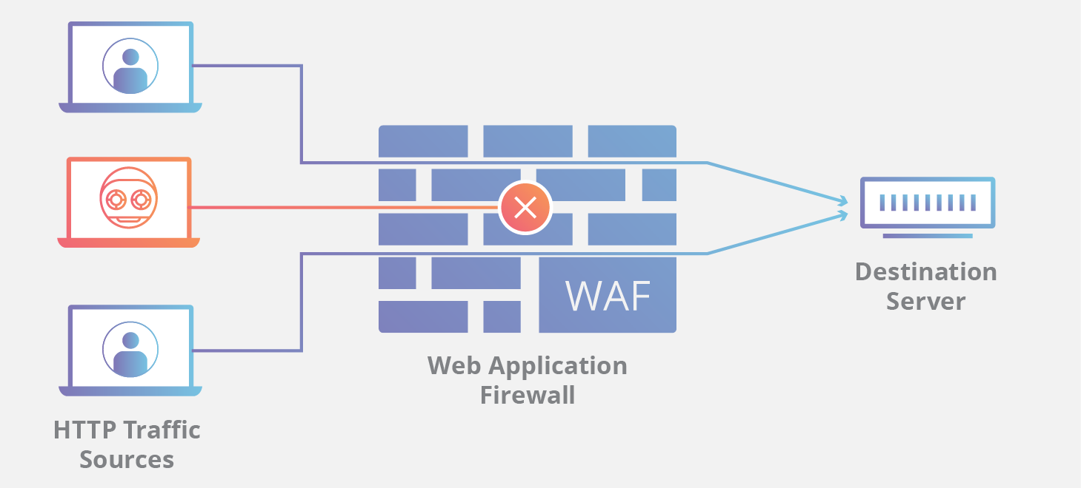

Slide 18
Types of WAS
A WAF can be implemented one of three different ways, each with it’s own benefits and shortcomings:
A network-based WAF is generally hardware-based. Since they are installed locally they minimize latency, but network-based WAFs are the most expensive option and also require the storage and maintenance of physical equipment.

Slide 19
Types of WAS…
A host-based WAF may be fully integrated into an application’s software. This solution is less expensive than a network-based WAF and offers more customizability. The downside of a host-based WAF is the consumption of local server resources, implementation complexity, and maintenance costs.

Slide 20
Types of WAS…
Cloud-based WAFs offer an affordable option that is very easy to implement; they usually offer a turnkey installation that is as simple as a change in DNS to redirect traffic. Cloud-based WAFs also have a minimal upfront cost, as users pay monthly or annually for security as a service.

Slide 21
How Can Secure Web Applications?

Slide 22
XSS - Protection
Protect your application from XSS attacks
Filter output by converting text/data which might have dangerous HTML characters to its encoded format:
'<' and '>' to '&lt;' and '&gt;’
'(' and ')' to '&#40;' and '&#41;’
'#' and '&' to '&#35;' and '&#38;‘
Recommend filtering on input as much as possible. (some data may need to allow special characters.)

Slide 23
Malicious File Execution Protection
Do not allow user input to be used for any part of a file or path name.
Where user input must influence a file name or URL, use a fully enumerated list to positively validate the value.
File uploads have to be done VERY carefully.
Only allow uploads to a path outside of the webroot so it can not be executed
Validate the file name provided so that a directory path is not
included.
Implement or enable sandbox or chroot controls which limit the applications access to files.

Slide 24
Cross Site Request Forgery (CSRF) Protection
Eliminate any Cross Site Scripting vulnerabilities
Not all CSRF attacks require XSS
However XSS is a major channel for delivery of CSRF attacks
Generate unique random tokens for each form or URL, which are not automatically transmitted by the browser.
Do not allow GET requests for sensitive actions.
For sensitive actions, re-authenticate or digitally sign the transaction.

Slide 25
Session Management: Protection
Use long complex random session ID that cannot be guessed.
Protect the transmission and storage of the Session ID to prevent disclosure and hijacking.
A URL query string should not be used for Session ID or any User/Session information
URL is stored in browser cache
Logged via Web proxies and stored in the proxy cache

Slide 26
Session Management: Protection
Entire session should be transmitted via HTTPS to prevent disclosure of the session ID.
Avoid or protect any session information transmitted to/from the client.
Session ID should expire and/or time-out on the Server when idle or on logout.
Client side cookie expirations useful, but should not be trusted.
Consider regenerating a new session upon successful authentication or privilege level change.

Slide 27
Broken Account Management
Even valid authentication schemes can be undermined by flawed account management functions including:
Account update
Forgotten password recovery or reset
Change password, and other similar functions

Slide 28
Broken Account and Session Management: Protection
Password Change Controls - require users to provide both old and new passwords
Forgotten Password Controls - if forgotten passwords are emailed to users, they should be required to re-authenticate whenever they attempt to change their email address.
Password Strength - require at least 7 characters, with letters, numbers, and special characters both upper case and lower case.
Password Expiration - Users must change passwords every 90 days, and administrators every 30 days.

Slide 29
Broken Account and Session Management: Protection…
Password Storage - never store passwords in plain text. Passwords should always be stored in either hashed (preferred) or encrypted form.
Protecting Credentials in Transit - to prevent "man-in-the-middle" attacks the entire authenticated session / transaction should be encrypted SSLv3 or TLSv1
Man-in-the-middle attacks - are still possible with SSL if users disable or ignore warnings about invalid SSL certificates.
Replay attacks - Transformations such as hashing on the client side provide little protection as the hashed version can simply be intercepted and retransmitted so that the actual plain text password is not needed.

Slide 30
Insecure Cryptographic Storage: Common Mistakes
Improper/insecure storage of passwords, certifications, and keys
Poor choice of algorithm
Poor source of randomness for initialization vectors
Attempting to develop a new encryption scheme "in house” (Always a BAD idea)
Failure to provide functionality to change encryption keys

Slide 31
Insecure Cryptographic Storage: Protection
Avoiding storing sensitive information when possible
Use only approved standard algorithms
Use platform specific approved storage mechanisms
Ask, read and learn about coding Best Practices for your platform
Careful review of all system designs
Source code reviews

Slide 32
Insecure Communications
Failure to encrypt network traffic leaves the information available to be sniffed from any compromised system/device on the network.
Switched networks do not provide adequate protection

Slide 33
Insecure Communications: Protection
Use SSL/TLS for ALL connections that are authenticated or transmitting sensitive information
Use SSL/TLS for mid-tier and internal network communications between Web Server, Application and database.
Configure Desktop Clients and Servers to ensure only SSLv3 and TLSv1 are used with strong ciphers.
Use only valid trusted SSL/TLS certificates and train users to expect valid certificates to prevent Man-in-the- Middle attacks.

Slide 34
Thank You

